Slide 1
STURGEON CREEK ARABIANS BREEDING PROGRAM TOP 11 ENDURANCE HORSES
Box 898, Beausejour, Manitoba CANADA R0E 0C0
Tel: 204-268-3437
www.sturgeoncreekarabians.com
Facebook: SturgeonCreekArabians

Slide 2
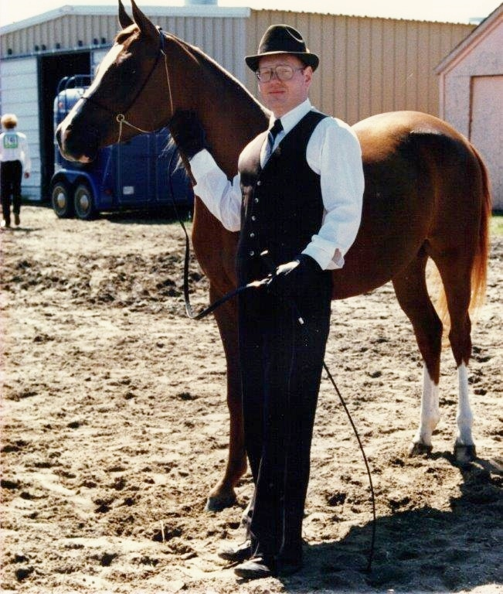
Moment of Mine (1984-2012) *El Kasaka x Magic Momment Sturgeon Creek Arabians (SCA) Foundation Mare
Dam of 10 (6 fillies, 4 geldings)
Dam of 4 successful endurance competitors, with many wins and Best Conditioned awards
Moment of Mine, 1986 Champion Mare, & Carl Fudge

Slide 3
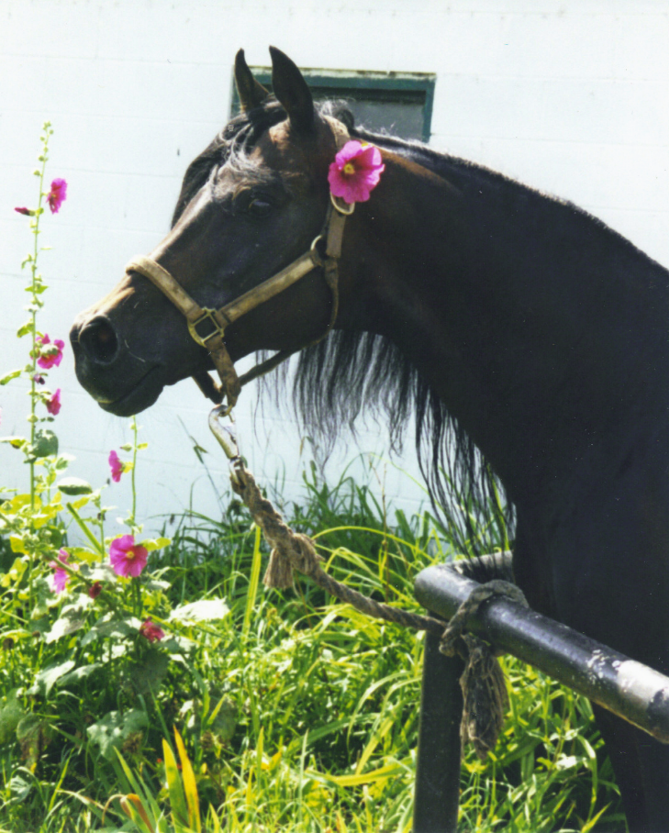
Pyatigorsk (1979-2003), Pietuszok Dwa x Mistical Lady SCA Foundation Stallion
Pyatigorsk ridden by Charlene Lewis , endurance trainer
A leading Canadian-bred Arabian sire
Stood at stud at SCA for 8 years (1993-2000)
Sire or grandsire of 21 of 27 SCA-bred endurance competitors

Slide 4
Reason To Believe (1998 - ) and Cheryl Dell, DVM Pyatigorsk x Resza
Members of Team USA, 2008 World Endurance Championship, Malaysia
US National and Regions 2 & 4, Endurance 100-mile Champion and Reserve Champion
27 Top Tens (11 wins, 6 Best Conditioned Awards) out of 29 races

Slide 5
SCA Dartagnan (1990 - ) and Myna Cryderman *El Kasaka x *Dolly
Members of Team Canada, 2002 World Endurance Championship, United Arab Emirates (UAE)
Region 6 Endurance Champion
Won multiple endurance races and Best Conditioned awards
2400 AERC Competitive miles
Training in the UAE

Slide 6
Mistansza (1992 - ) and Charlene Lewis *Sekstans x Moment Of Mine
Endurance winner, 14 Top Tens and 2 Best Conditioned Awards
Completed the 1998 Tevis Cup
Completed 49 of 52 rides for over 2600 miles
Climbing Cougar Rock, 1998 Tevis Cup

Slide 7
Be My Love (1996 - ) and Susan Friedman Pyatigorsk x Balalovja
AERC Decade Team members (2003-2012)
Race Winner, 12 Top Tens, 94% completion rate (53 starts)
Still competing in 2014

Slide 8
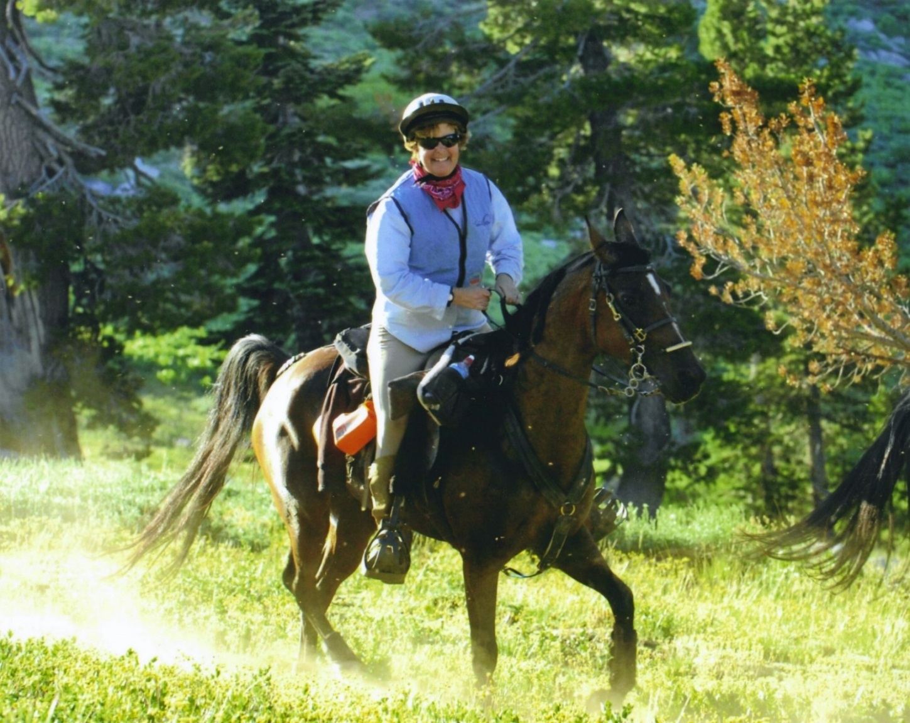
Spirited Music (1996 - ) and Brooke Schick
Pistaschio x Kaluwa
AERC Decade Team members (2002-2013)
Completed the 2006 Tevis Cup
92% completion rate (57 starts)
Still competing
2006 Tevis Cup

Slide 9
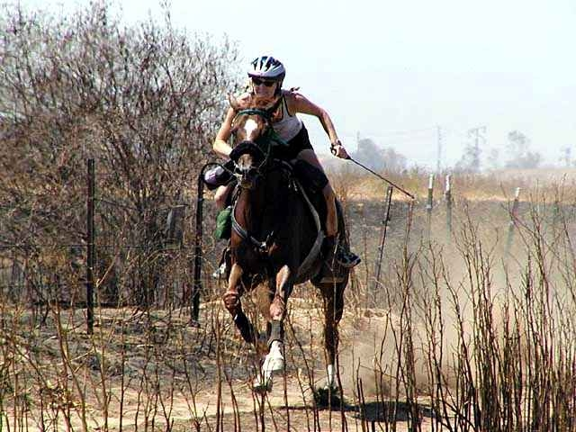
Seek The Moment (1995 - ) and Cheryl Dell, DVM
*Sekstans x Moment Of Mine
2001 Region 1 50-Mile Endurance Champion
Top Ten in 25 of 26 Completions (1425 miles, 12 wins, 6 seconds, 1 Best Conditioned Award)
Winning the 2001 Norco Region1, Championship

Slide 10
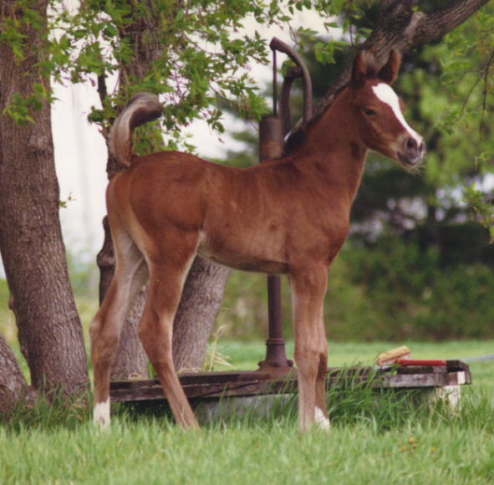
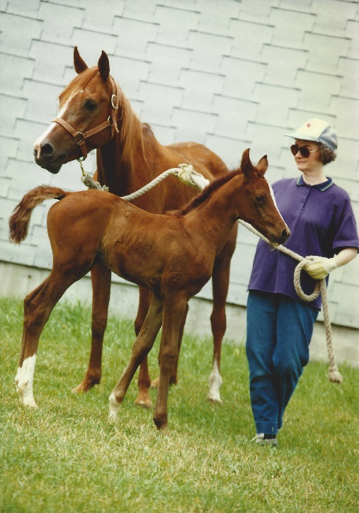
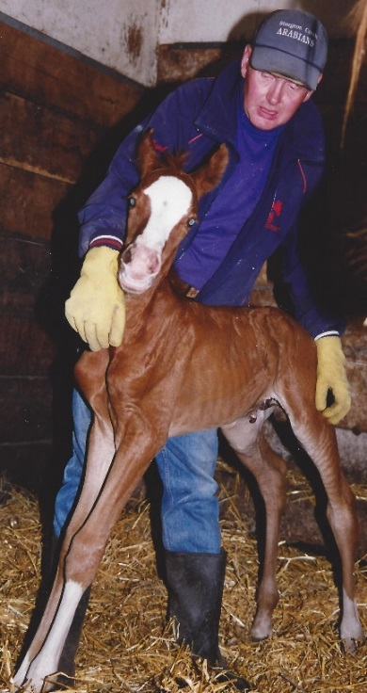
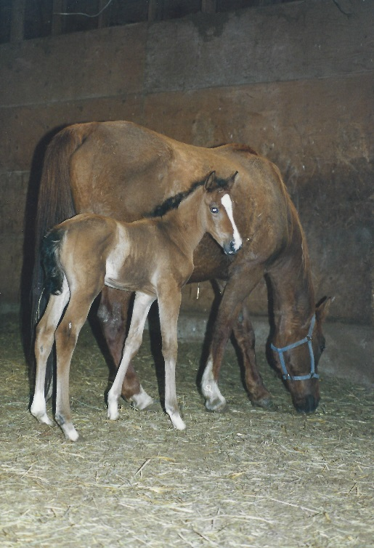
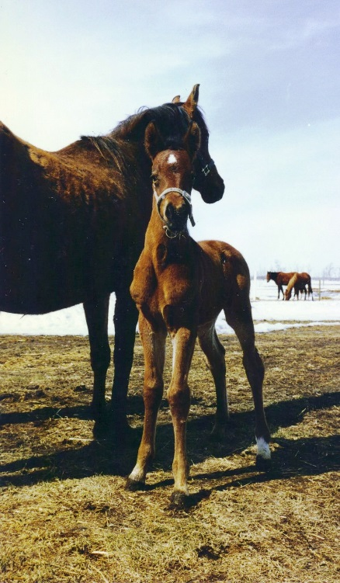
Endurance
Foals
Savour The Moment (1994- ) *Sekstans x Moment of Mine
2540 miles, 5 wins, 7 seconds
Mabelline (1996-2011) Pistaschio x Maybe Mee 1770 miles, 3 Top Ten
Paradigm Shift (1998- ) Pyatigorsk x My Madame
100% completions, 1 win
Hiroko (1997- ) Pyatigorsk x My Madame
12 Top Tens, 1 BC
Power Ranger (1996- )
Pyatigorsk x TW Czorta
9 Top Ten, 1 win, 2 2nd

